Slide 1
Operational Management Suite Hands-On Labs

Slide 2
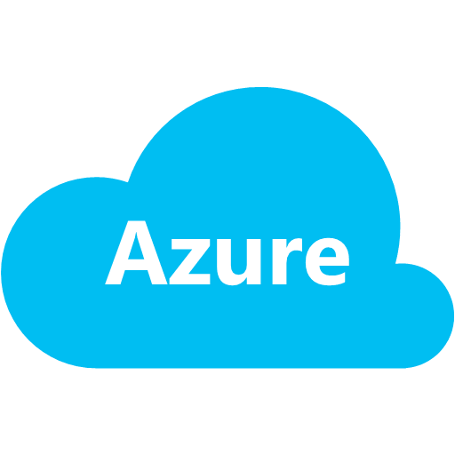
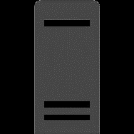
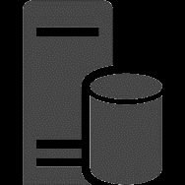
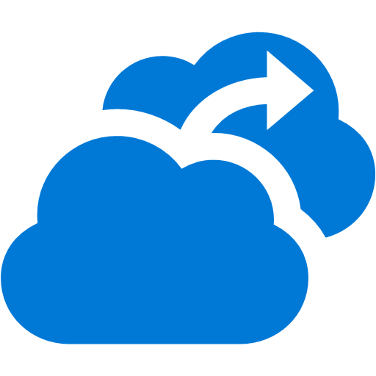

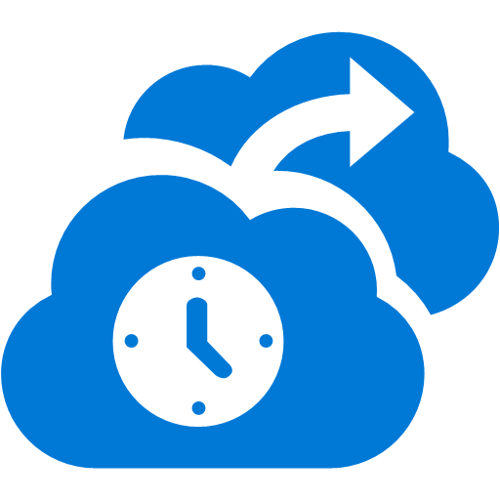


HOL Scenario
SSID : MSFTOPEN
xxHOLApp
: LOB Applications
: Azure Mobility Service / Agent
Student machine
xxHOLPs : Azure Management / Process Server
Replicate Traffic
Azure Site Recovery
Remote Desktop
xxHOLFile
: File Server
: Backup Agent
Backup Traffic
Azure Backup
xx = Your prefix name
e.g. az816 and etc.
On-Premise Simulation Environment
Azure Operational Insights
100 USD Azure Pass Credit for 30 days

Slide 3
01 - Get Free Email via Office 365 and Active Azure Trial

Slide 4
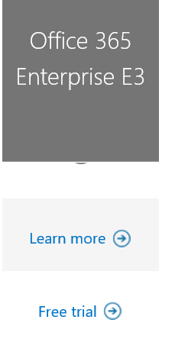
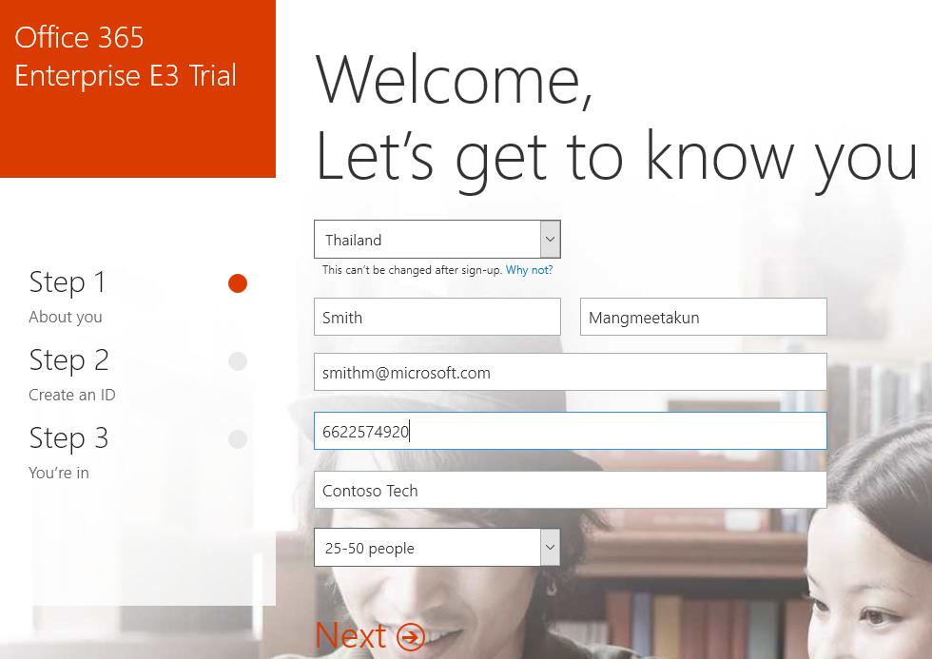
Get Free Email from Office 365 Trial
Step 1 : Define your own tenant name (yourtenantname): e.g. az816
Step 2 : Open http://aka.ms/o365plan and click Free trial
Step 3 : Follow the process to create trial tenant

Slide 5
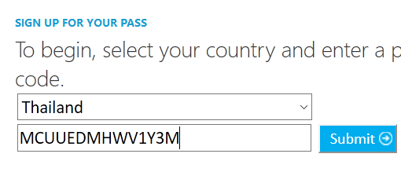
Get Azure Trial
Step 1 : Get Azure Pass Promo Code from Instructor
Step 2 : Open https://www.microsoftazurepass.com/
Step 3 : Select Thailand and Enter Promo Code then click Submit
Step 4 : Confirm information then click Submit
Step 5 : Confirm to use Azure Pass by click Active and Click Sign-up
Step 6 : Wait for service provisioning then click Start managing my service >

Slide 6
02 - Create 3 machines to use in HOL
xxHOLApp
: LOB Applications
: Azure Mobility Service / Agent
xxHOLPs : Azure Management / Process Server
xxHOLFile
: File Server
: Backup Agent

Slide 7
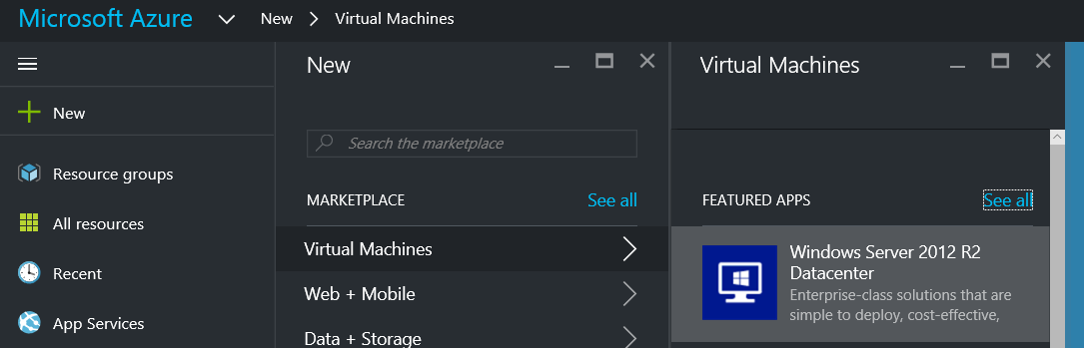
Create HOLApp Machine
Logon to portal.azure.com then select New -> Virtual Machines -> Windows Server 2012 R2 Datacenter
Select a deployment model -> Resource Manager then click Create
In Basics tab, enter following value
Name : xxxholapp (where xxx is your prefix e.g. az816)
User name: holadmin
Password: QAZwsx@123456
Resource Group : Create New then type HOL
Location : Southeast Asia, click Ok
In Size tab, select DS1_V2 Standard, click Select, in Settings tab leave all default value then click Ok
In Summary Tab, click Ok

Slide 8
Create HOLPs Machine
Open portal.azure.com then select New -> Virtual Machines -> Windows Server 2012 R2 Datacenter
Select a deployment model -> Resource Manager then click Create
In Basics tab, enter following value
Name : xxxholps (where xxx is your prefix e.g. az816)
User name: holadmin
Password: QAZwsx@123456
Resource Group : Use existing then select HOL
Location : Southeast Asia, click Ok
In Size tab, select DS1_V2 Standard, click Select, in Settings tab leave all default value then click Ok
In Summary Tab, click Ok

Slide 9
Create HOLFile Machine
Open portal.azure.com then select New -> Virtual Machines -> Windows Server 2012 R2 Datacenter
Select a deployment model -> Resource Manager then click Create
In Basics tab, enter following value
Name : xxxholfile (where xxx is your prefix e.g. az816)
User name: holadmin
Password: QAZwsx@123456
Resource Group : Use existing then select HOL
Location : Southeast Asia, click Ok
In Size tab, select DS1_V2 Standard, click Select, in Settings tab leave all default value then click Ok
In Summary Tab, click Ok

Slide 10
Setup Static IP Address for Configuration/Process Server
Click Virtual machines at Left Navigation
Click Settings > Network interfaces > instance name > All settings -> IP addresses
Change IP address from Dynamic to Static
Click Save

Slide 11


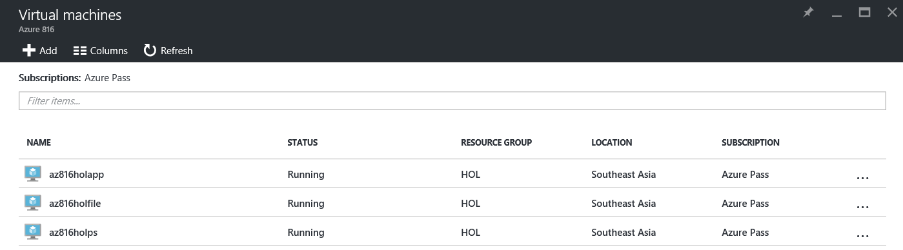

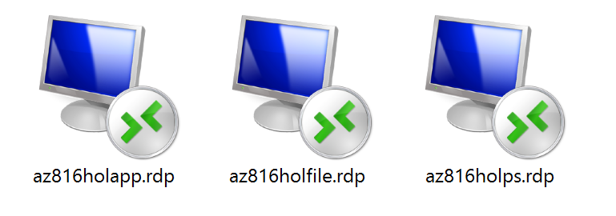
Validate Machine Creating Tasks
Click Virtual machines at Left Navigation
Wait and click Refresh until all machine are in Running Stage
Click at one VM (any), then click Connect
Save .rdp file for further usage
Do it all other VM

Slide 12
03 - Getting Started with OMS

Slide 13
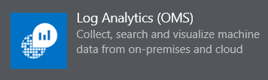
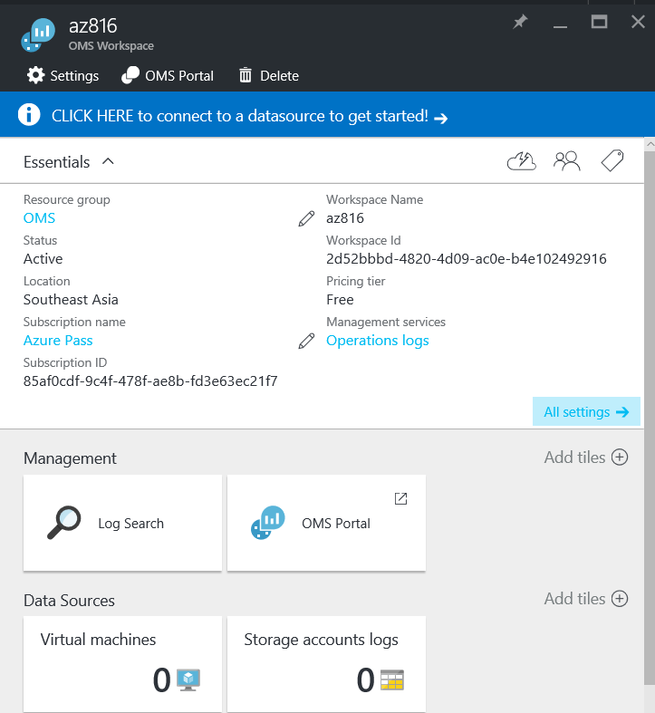
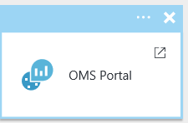
Create a Microsoft Operations Management Suite Workspace
Logon to portal.azure.com then select New -> Management -> Log Analytics (OMS)
Enter following value
OMS Workspace : xxx (where xxx is your prefix e.g. az816)
Resource Group : OMS
Location : Southeast Asia, click Ok
Wait until OMS Workspace created
Select Resource groups -> OMS
Select your Log Analytics instance
Click OMS Portal

Slide 14
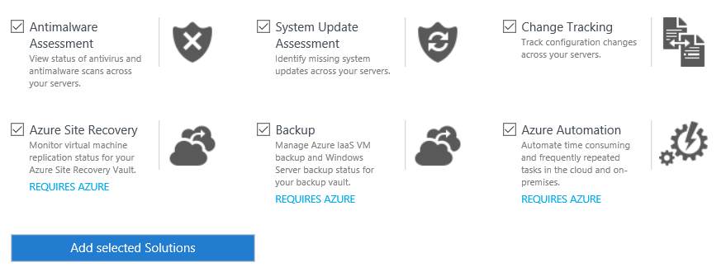

Configure OMS Settings
On the Overview blade, scroll to the right and click the Settings tile.
Review the available Solutions.
Ensure all available solutions are selected and click Add selected Solutions.
Select DATA tab then, select Windows Event Logs click Enter the name of the event log to monitor.
Type Microsoft-Windows-WinRM/Operational and click the plus sign.
Select the check boxes next to ERROR, WARNING, and INFORMATION
Type Microsoft-Windows-TCPIP/Operational and click the plus sign.
Select the check boxes next to ERROR, WARNING, and INFORMATION
Under Windows Performance counters, review the available counters and click Add the selected performance counters.
Click SAVE.

Slide 15

Configure xxxHOLFile as a Connected Source via a Direct Agent
logged on to xxxHOLFile as HOLAdmin with the password QAZwsx@123456
Turn Off, Internet Explorer Enhanced Security, Server Manager -> Local Server -> IE Enhanced Security Configuration
Administrators : Off
User : Off
Open Internet Explorer go to following homepage http://www.microsoft.com/en-us/server-cloud/operations-management-suite/overview.aspx
Click Sign in
Enter the credentials associated with OMS, and click Sign in again.
Click the OMS Workspace name. (If registration windows appear click Skip)
On the dashboard, scroll to the right and click the Settings tile.
On the Settings blade, click CONNECTED SOURCES.

Slide 16

Configure xxxHOLFile as a Connected Source via a Direct Agent (2)
Under ATTACH COMPUTERS DIRECTLY, click Download Windows Agent (64 bit).
Click Run.
In the Microsoft Monitoring Agent Setup Wizard, click Next then Click I Agree.
On the Destination Folder page, click Next.
Click the checkbox next to Connect the agent to Azure Log Analytics (OMS) and click Next.
Switch to the OMS Settings blade, click the Copy icon next to WORKSPACE ID, and click Allow access.
Switch to the Microsoft Monitoring Agent Setup wizard, click in the Workspace ID field in the Wizard, and press CTRL-V.
Switch to the OMS Settings blade, click the Copy icon next to PRIMARY KEY and click Yes.
Switch to the Microsoft Monitoring Agent Setup wizard, click in the Workspace Key field in the Wizard, and press CTRL-V. Click Next then Click Install and Click Finish
Right-click Start and click Control Panel, change View to Large icons Click Microsoft Monitoring Agent, select tab Azure Log Analytics (OMS)

Slide 17

Customize the OMS Dashboard
Open OMS Portal http://www.microsoft.com/en-us/server-cloud/operations-management-suite/overview.aspx, to the left click My Dashboard icon
Click CUSTOMIZE.
From the menu on the right, under Change Tracking, select All Configuration Changes and drag it onto My Dashboard.
Under System Update Assessment, select All computers with missing critical or securityupdates and drag it onto My Dashboard.
Drag several additional items (your choice to select all any) to My Dashboard.
On My Dashboard, click All Configuration Changes.
Under TILE VISUALIZATION, click 123.
Under THRESHOLD, click on.
In value, type 2.
Click CUSTOMIZE.

Slide 18



Add Microsoft Operations Management Suite Solutions to the OMS Console
In OMS, click the Overview icon.
Click the Usage tile. Review the type of data revealed in the tile.
Click the Overview icon, click the Solutions Gallery tile.
Click the Solutions Gallery, Click AD Assessment, click Add
Click Solutions Gallery, Click SQL Assessment and click Add
Click the Solutions Gallery, Click Security and Audit and click Add.
Click the Solutions Gallery, Click Office 365 (Preview) and click Add, at Office 365 tile click Requires Configuration
At CONNECTED SOURCES in OFFICE 365 (PREVIEW) click Connect Office 365
Provide Office 365 login and click Accept
Leave Machine run for 24 hours to completely send all data to OMS

Slide 19
04 - Performing Log Analytics with OMS

Slide 20
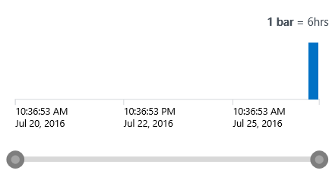

Using OMS Search
On the OMS Overview blade, click Log Search.
Under A few more queries to try locate the All computer with missing critical or security updates and Click
Click Table and review the result and
In the diagram at the top of the Facet Panel, hover over a bar.
Click on a bar to display data based on that custom time range.
Scroll through the Facet Panel to become familiar with the data being displayed.
Click +Add, review the items that can to be added to the Facet Panel close the Add window.
Click Tab Updates, review information in the dashboard.
Back to Home, click System Update Assessment tile, review information in the dashboard
Explore COMMON UPDATE QUERIES in the right panel

Slide 21
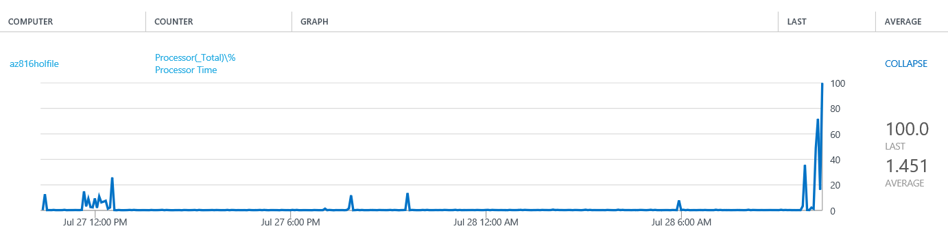
Examine Performance Data in OMS
In the OMS Portal, click the Overview icon.
Click the Log Search tile.
In the query field, type * and click Search.
In the Facet Panel under Type, click Perf, then select Processor under OBJECTNAME click Apply
At the top of the Results Panel, click Metrics (where xx is the number of metrics available).
To the right of the graph for each solution, click on the [+] plus sign to expand the graph.
Drill down through the various items to see how they are displayed.

Slide 22

Trigger Alert for critical events
In the OMS Portal, click the Overview icon.
Click the Log Search tile.
In the query field, type * and click Search.
In the Facet Panel under Type, click Perf, then select Processor then select % Processor Time
In Search query add following syntax CounterValue>90 Note: your query must look like * Type=Perf ObjectName=Processor CounterName=“% Processor Time”CounterValue>90
In Ribbon menu click Alert
Enter following parameter
Name : CPU Peak Alert
Time window : 5 Minutes
Alert frequency : 5 Minutes
Number of results : Greater than 5
Email notification Subject : Warning CPU Peak Alert !!!
Recipients (semi-colon separated) : Enter your email
Click Save

Slide 23
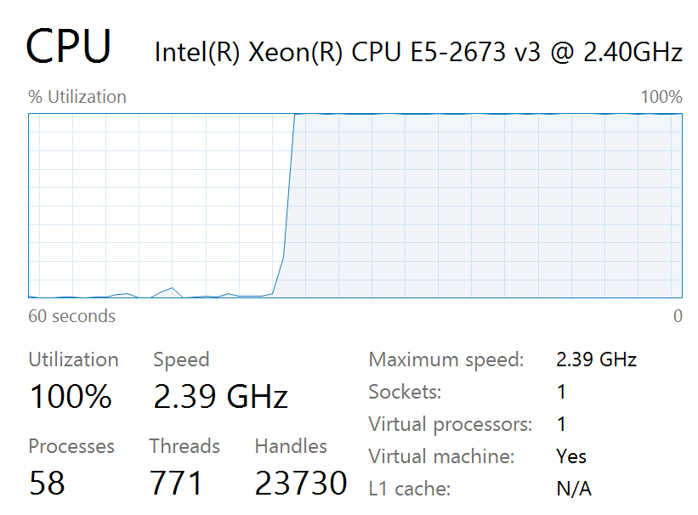
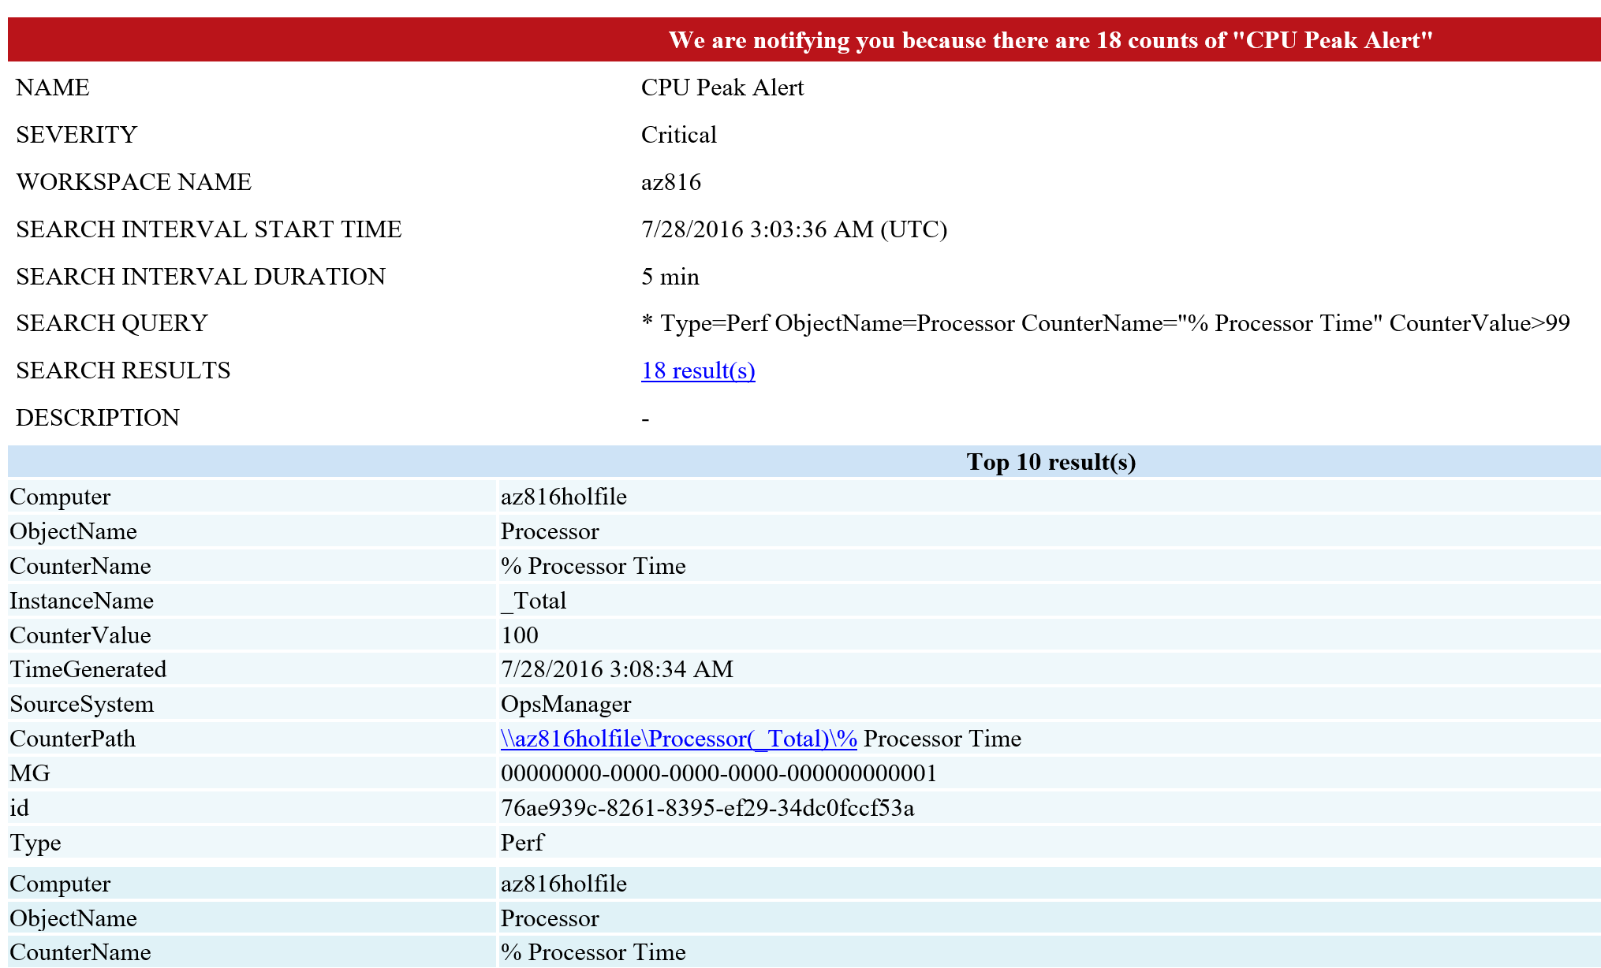
Generate CPU Peak on Target Machine
Remote desktop to xxxHOLFile
Open Internet Explorer and then enter following URL http://cpuburnin.com/
Click Download CPU Burn-in v1.01 (Win95/98/NT/2k)
Open CPU Burn-in application, click Run 2 times
Enter Run CPU test for 1 hours and then click Start
Open Task Manager and check CPU usage
Wait for 10 minutes, Close CPU Burn-in Applications
Check your email

Slide 24
05 - Getting Started with Azure Backup

Slide 25


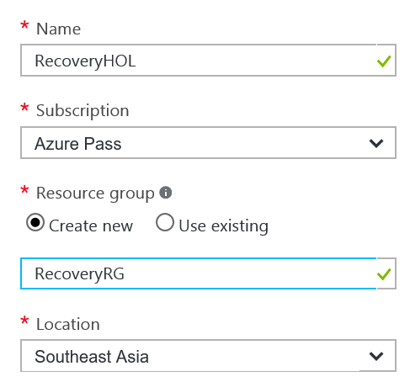
Create Azure Backup Vault
Navigate to Azure Management Portal http://portal.azure.com
Click + New button
Type Backup and Site Recovery (OMS) then press Enter
Select Backup and Site Recovery (OMS) then click Create
Typing following input then click Create
Name: RecoveryHOL
Resource group : Create new
Name : RecoveryRG
Location : Southeast Asia
Click Create

Slide 26
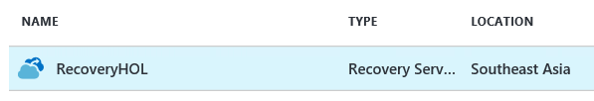
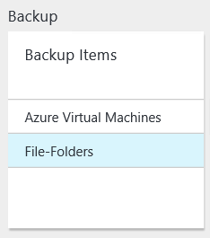
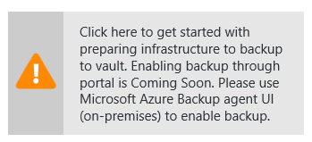
Register Computer Protected by Azure Backup Service
logged on to xxxHOLFile as HOLAdmin with the password QAZwsx@123456
Navigate to Azure Management Portal http://portal.azure.com
Click Resource groups then select RecoveryRG
Click Recovery Service name RecoveryHOL
At Recovery service, click File-Folders at Backup Tile under Backup Items
In Backup Items click + Add
Under Step 1 Backup goal select
Where is your workload running : On-premises
What do you want to backup? : File and folders
Click warning message

Slide 27
Register Computer Protected by Azure Backup Service (2)
In Azure Backup Agent page, click Download Agent for Windows Server or Windows Client
Click Run, then click Next to start install Backup Agent, leave proxy settings on default value click Next and then select Use Microsoft Update when I check for update (recommended) then click Next
Wait until installation process finish during this time switch back to Internet Explorer
Click Download vault credentials that your will use during the agent installation to register the server in the vault.
Save the Vault Credentials to Desktop
Switch back to Installation (should finished) then click Proceed to Registration
At Vault Credentials click Browse and select the Vault Credentials file on Desktop then click Next
Click Generate Passphrase then click Browse to save passphrase to Desktop
Click Finish, wait for the registration then click Close button

Slide 28
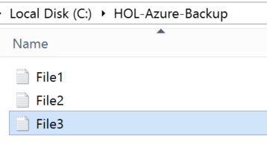
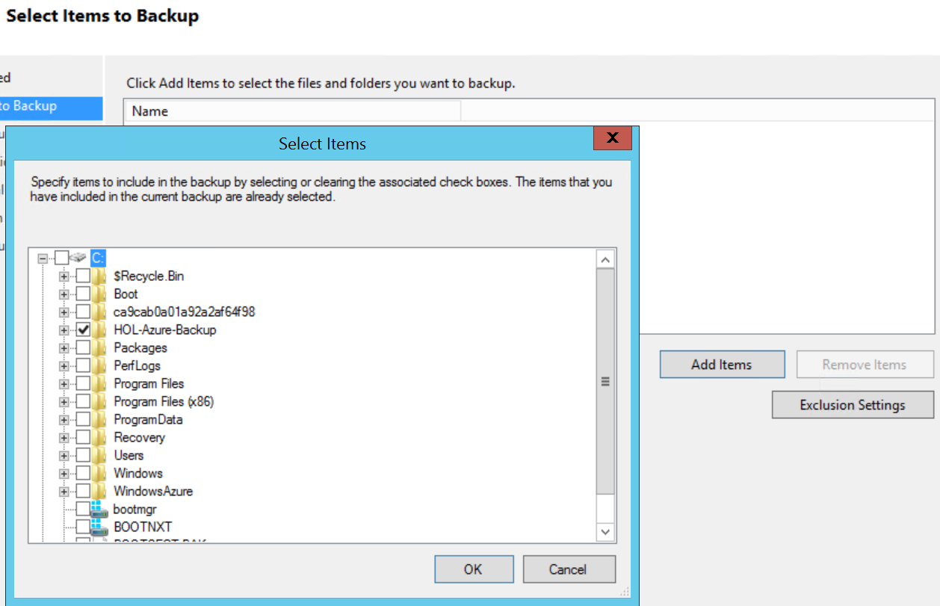
Protecting File-Folder on Computer
Create a folder called HOL-Azure-Backup on your laptop C:\ and copy some files into it
Switch to Microsoft Azure Backup, Click on Schedule Backup on Microsoft Azure Backup application
On Getting started click Next, then Select the HOL-Azure-Backup folder by selecting Add Items as shown then click Next
Specify daily time to backup data
Specify the daily retention, weekly, monthly and yearly backup schedule and retention periods
Keep the default option of Automatically over the network
Verify the configuration parameters are correct and click Finish
All files in the folder HOL-Azure-Backup will be backed up to Azure Backup.
You can also click Backup Now to immediately run backup job

Slide 29
Protect Azure IaaS Virtual Machine
Navigate to Azure Management Portal http://portal.azure.com
Click Resource groups then select RecoveryRG
Click Recovery Service name RecoveryHOL
At Recovery service, click Azure Virtual Machines, in Backup Items click + Add
Under Step 1 Backup goal select
Where is your workload running : Azure
What do you want to backup? : Virtual machine
Click Ok
Leave backup policy to default value then click Ok
In Select virtual machines select xxxHOLFile then click Select and click Enable backup

Slide 30
06 - Getting Started with Azure Site Recovery

Slide 31
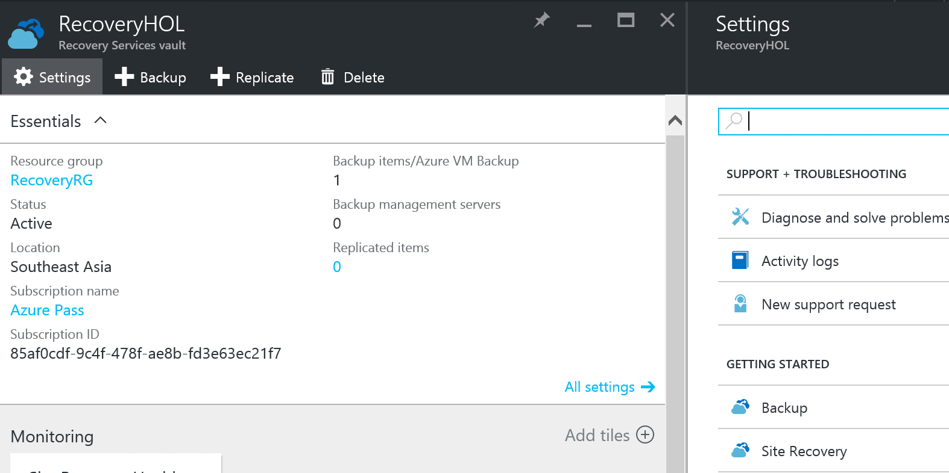
Step 1: Choose your protection goals
logged on to xxxHOLPs as HOLAdmin with the password QAZwsx@123456
Turn Off, Internet Explorer Enhanced Security, Server Manager -> Local Server -> IE Enhanced Security Configuration
Administrators : Off User : Off
Navigate to Azure Management Portal http://portal.azure.com
Click Resource groups then select RecoveryRG
Click Recovery Service name RecoveryHOL
Click Settings > Getting Started click Site Recovery
Click Step 1: Prepare Infrastructure > Protection goal.
In Protection goal select To Azure, and select Yes, with VMware vSphere Hypervisor. Then click OK.

Slide 32
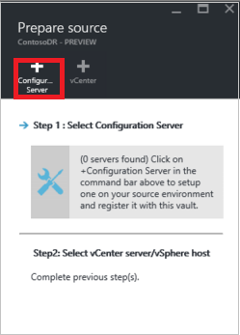
Step 2: Set up the source environment
Click Step 1: Prepare Infrastructure > Source. In Prepare source if you don’t have a configuration server click +Configuration server to add one.
In the Add Server blade check that Configuration Server appears in Server type.
Before you set up the configuration server verify prerequisites. In particular check that the machine can access the required URLs.
In step 3 : Click Download the Site Recovery Unified Setup installation file, and Save into Download folder
Click Download the vault registration key. You'll need this when you run Unified Setup. The key is valid for 5 days after you generate it.
Run Unified Setup to install the configuration server, the process server, and the master target server.
In Before you begin select Install the configuration server and process server.
In Third-Party Software License click I Accept to download and install MySQL.

Slide 33
Step 2: Set up the source environment (2)
select Connect with existing proxy settings, then click Next
In Prerequisites Check setup runs a check to make sure that installation can run.
In MySQL Configuration create credentials for logging onto the MySQL server instance that will be installed, enter root and MySQL password (QAZwsx@123456) then click Next
In Environment Details select whether you're going to replicate VMware VMs. If you are then setup checks that PowerCLI 6.0 is installed (Select No) then click Next
In Install Location select where you want to install the binaries and store the cache, then click Next
In Network Selection specify the listener (network adapter and SSL port) leave the default port (9443) then click Next
In Registration browse and select the registration key you downloaded from the vault click Next
In Summary review the information and click Install
After registration finishes the server is displayed in the Settings > Servers blade in the vault.

Slide 34
Step 2: Set up the source environment (3)
Open Notepad and paste (Crtl-V) to paste passphrase into Notepad and then Save into Desktop *** Warning You'll need it when you enable replication so copy it and keep it in a secure location.
Open CSPSConfigtool.exe. It's available as a shortcut on the desktop and located in the [INSTALL LOCATION]\home\svsystems\bin folder.
Click Manage Accounts > Add Account.
In Account Details add the account that will be used for automatic discovery
Friendly name : vCenter
User name : holadmin
Password : QAZwsx@123456
Note that it can take 15 minutes or more for the account name to appear in the portal.
Switch to Azure Portal -> Site Recovery

Slide 35
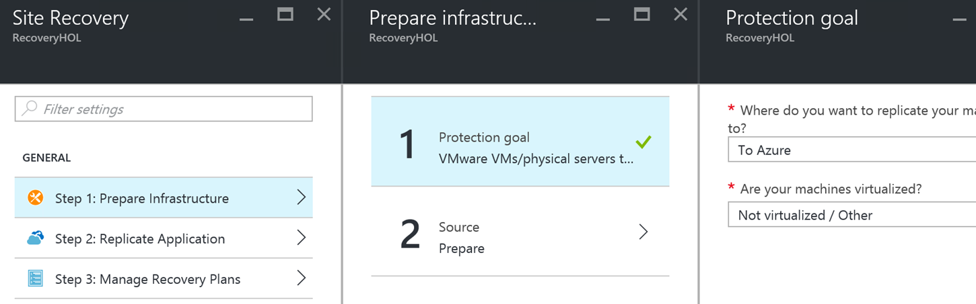
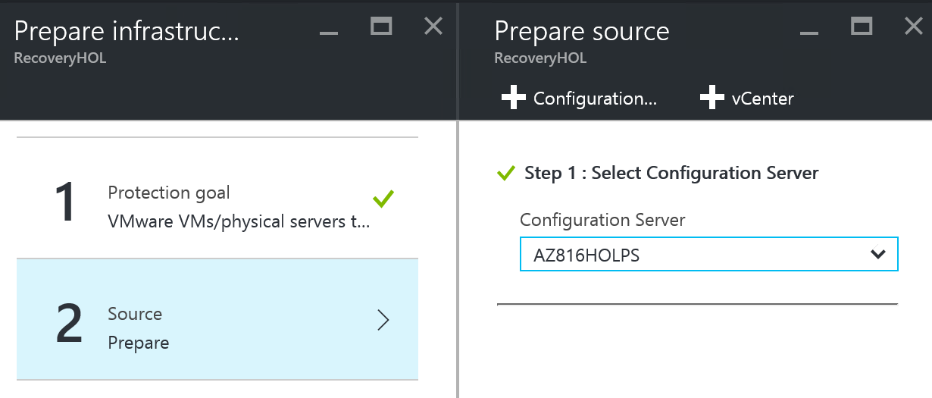
Step 2: Set up the source environment (3)
Select Step 1 : Prepare Infrastructure > Protection goal
Where do you want to replicate your machine to : To Azure
Are your machine virtualized? : Not virtualized / Other , click Ok
Select Step 1 : Prepare Infrastructure > Source your configuration server should appear here, click Ok

Slide 36
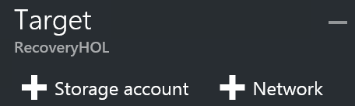
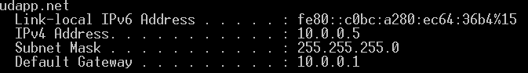
Step 3: Set up the target environment
Click Prepare infrastructure > Target and select the Azure subscription you want to use.
Specify the deployment model you want to use for VMs after failover, select Resource Manager
Site Recovery checks that you have one or more compatible Azure storage accounts and networks,
Click + Storage account
On the Create storage account, click Create New and specify following information:
Account name : xxxholstroage
Replication : Local-redundant storage (LRS), then click Ok
Click + Network, On the Choose Virtual Network, click Create New and leave all pre-populate setting then click Ok
Open command prompt then type ipconfig, take note your IP address

Slide 37
Step 4: Set up replication settings
To create a new replication policy click Prepare infrastructure > Replication Settings > +Create and Associate.
In Create and associate policy specify a policy name : HOLPolicy
In RPO threshold: specify the RPO limit. Alerts will be generated when continuous replication exceeds this limit.
In Recovery point retention, specify in hours how long the retention window will be for each recovery point. Protected machines can be recovered to any point within a window. Up to 24 hours retention is supported for machines replicated to premium storage.
In App-consistent snapshot frequency, specify how often (in minutes) recovery points containing application-consistent snapshots will be created.
When you create a replication policy, by default a matching policy is automatically created for failback. For example if the replication policy is rep-policy then the failback policy will be rep-policy-failback. This policy isn't used until you initiate a failback.
Click OK to create the policy.
When you create a new policy it's automatically associated with the configuration server. Click OK.

Slide 38
Step 5: Capacity planning
Click Download to download the tool and then run it. Read the article that accompanies the tool.
When you’re done select Yes in Have you completed capacity planning?
Open the Microsoft Azure Backup MMC snap-in on the machine acting as the process server. By default a shortcut for Microsoft Azure Backup is available on the desktop or in C:\Program Files\Microsoft Azure Recovery Services Agent\bin\wabadmin.
In the snap-in click Change Properties.
On the Throttling tab review Enable internet bandwidth usage throttling for backup operations, and available option to set the limits for work and non-work hours.
Restart Server to complete Configuration/Process server installation

Slide 39
07 - Replicate applications

Slide 40
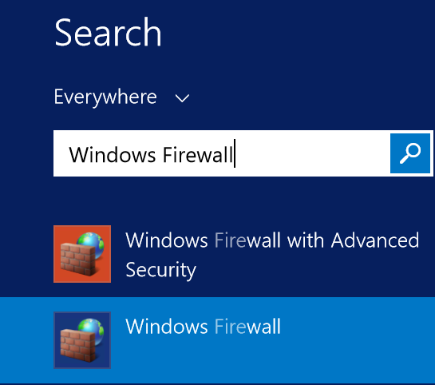
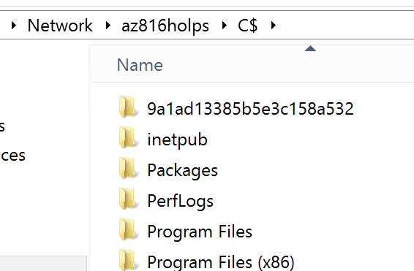
Enable File Sharing on Process Server to Install Mobility Service Manually
Remote to xxxHOLPs and then click Start menu then type Firewall and select Windows Firewall
Select Allow an app or feature through Firewall. Enable File and Printer Sharing
Ensure that TCP and UDP rules are also RDP enabled for the Public Click Ok
Remote to xxxHOLApp and open File Explore then type \\xxxHOLPs\c$
Verified xxxHOLApp can successfully access to xxxHOLPs

Slide 41
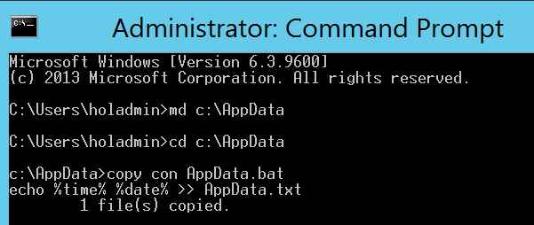
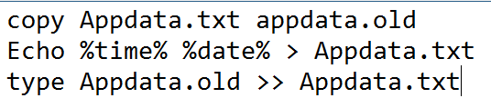
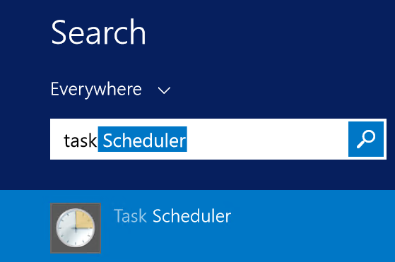
Simulate Application Data to generate transaction on xxxHOLApp
Remote to xxxHOLApp
Right-Click Start then select Command Prompt
Type following command
md c:\appdata then Enter
cd c:\appdata then Enter
Copy con appdata.bat then type following code
Press Ctrl-C

Slide 42
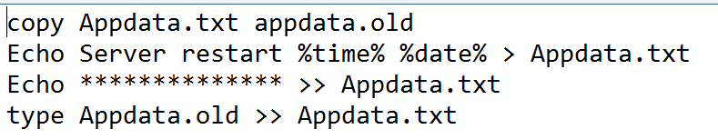
Simulate Application Data to generate transaction on xxxHOLApp (2)
Type following command
md c:\appdata then Enter
cd c:\appdata then Enter
Copy con Reboot.bat then type following code
Press Ctrl-C
Open Start Menu, type Task Scheduler then press Enter

Slide 43
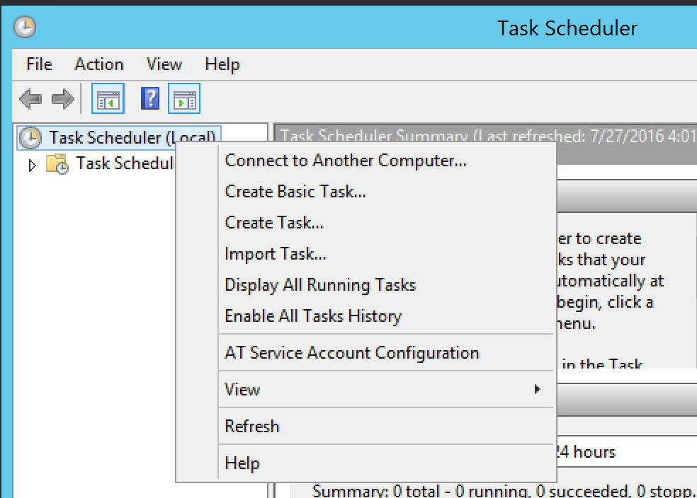
Simulate Application Data to generate transaction on xxxHOLApp (3)
On Task Schedule (Local), right-click then select Create Task
Enter following data on General Tab
Name : Generate AppData
Select : Run whether user is logged on or not
In Triggers, click New and insert following parameter
Begin the task : On a Schedule
Repeat task every : 1 minutes
For a duration of : Indefinitely
Enable : Checked
Click Ok

Slide 44
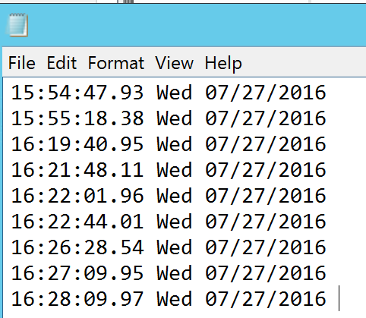
Simulate Application Data to generate transaction on xxxHOLApp (4)
In Action, click New and provide following parameter
Action : Start a program
Program/script : c:\appdata\appdata.bat
Start In : c:\appdata\
Click Ok
Windows Credential prompt will display, enter HOLAdmin credential
Under Task Scheduler Library, right-click Generate AppData then click Run
Wait for 3 minutes and verified the result on c:\appdata\appdata.txt

Slide 45
Simulate Application Data to generate transaction on xxxHOLApp (5)
On Task Schedule (Local), right-click then select Create Task
Enter following data on General Tab
Name : Reboot Log
Select : Run whether user is logged on or not
In Triggers, click New and insert following parameter
Begin the task : At Startup
Enable : Checked
Click Ok

Slide 46
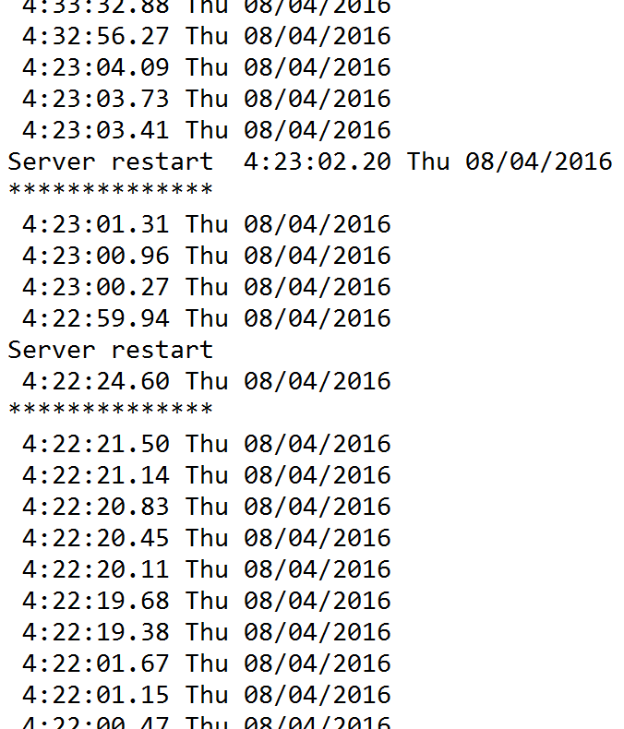
Simulate Application Data to generate transaction on xxxHOLApp (6)
In Action, click New and provide following parameter
Action : Start a program
Program/script : c:\appdata\reboot.bat
Start In : c:\appdata\
Click Ok
Windows Credential prompt will display, enter HOLAdmin credential

Slide 47
Install Mobility Service on target server
For Non-Domain Join machine, disable Remote User Access control on the local machine by open Registry Editor by right-click on Start menu and click Command Prompt
Type following command and then press Enter REG ADD HKEY_LOCAL_MACHINE\SOFTWARE\Microsoft\Windows\CurrentVersion\Policies\System /v LocalAccountTokenFilterPolicy /t REG_DWORD /d 1
On the Windows Firewall of the machine you want to protect, select Allow an app or feature through Firewall. Enable File and Printer Sharing and Windows Management Instrumentation
The installers are available on the process server in \\xxxHOLPs\C$\Program Files (x86)\Microsoft Azure Site Recovery\home\svsystems\pushinstallsvc\repository.
Download and run the relevant installer.
In Before you begin select Mobility service.

Slide 48
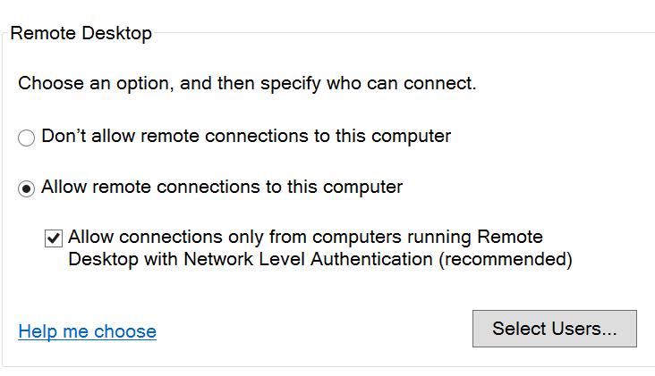
Install Mobility Service on target server (2)
In Configuration Server Details specify the IP address of the configuration server (10.0.0.5) and the passphrase that was generated when you ran Unified Setup (\\xxxHOLPs\C$\users\holadmin\desktop). You can retrieve the passphrase by running: \home\sysystems\bin\genpassphrase.exe –n on the configuration server.
In Install Location leave the default setting and click Next to begin installation.
In Installation Progress monitor installation and restart the machine if prompted. After installing the service it can take around 15 minutes for status to update in the portal.
Right-Click on Start, select System
Click Remote settings
Ensure Allow remote connections to this computer are checked

Slide 49
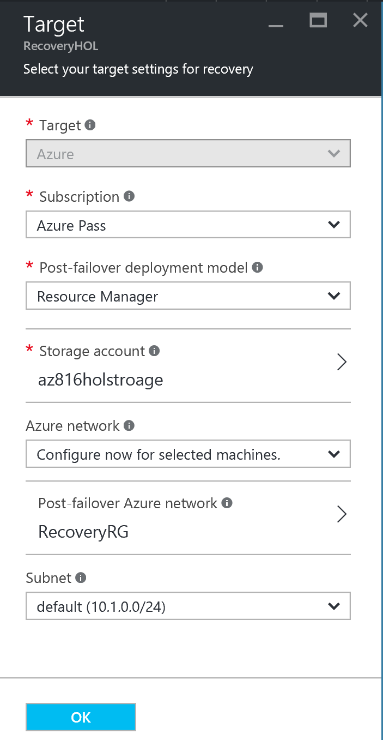
Enable Replication
Switch back to Azure Portal at Site Recovery
Click Step 2: Replicate application > Source. After you've enabled replication for the first time you'll click +Replicate in the vault to enable replication for additional machines.
In the Source blade > Source select the configuration server, In Machine type select Physical Machines.
Select process server (default) then click Ok
In Target blade > enter following parameter
Post-failover deployment model : Resource Manager
Storage account : xxxholstroage
Azure network : RecoveryRG
Subnet : default (10.1.0.0/24), click Ok

Slide 50
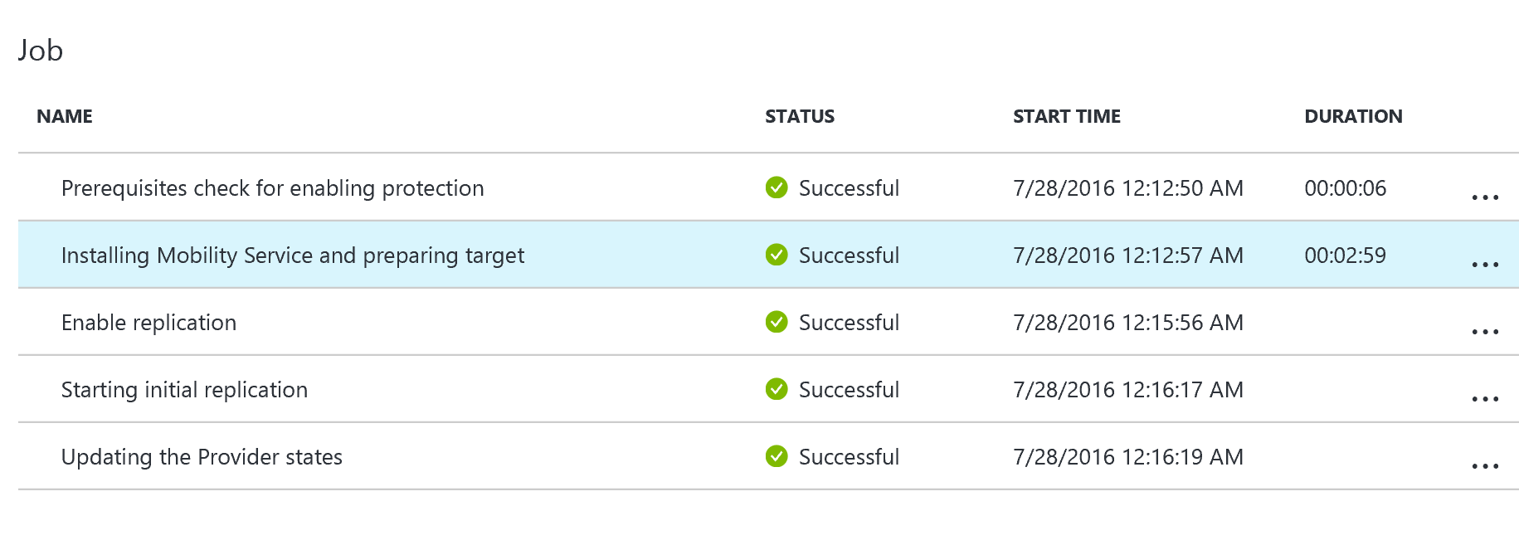
Enable Replication (2)
In Physical machines blade > click + Physical machine
Enter following parameter
Name : xxxholapp
IP Address : your IP address
OS Type : Windows, click Ok
Select xxxholap machine then click Ok
In Properties > Configure properties,. click All Disks then click OK.
In Replication settings > Configure replication settings then click Ok
Click Enable Replication. You can track progress of the Enable Protection job in Settings > Jobs > Site Recovery Jobs. After the Finalize Protection job runs the machine is ready for failover.

Slide 51
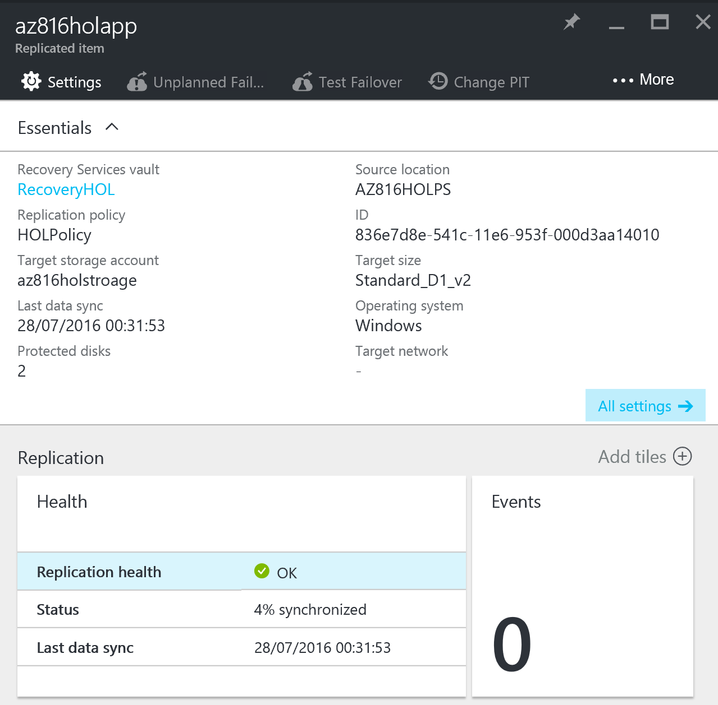
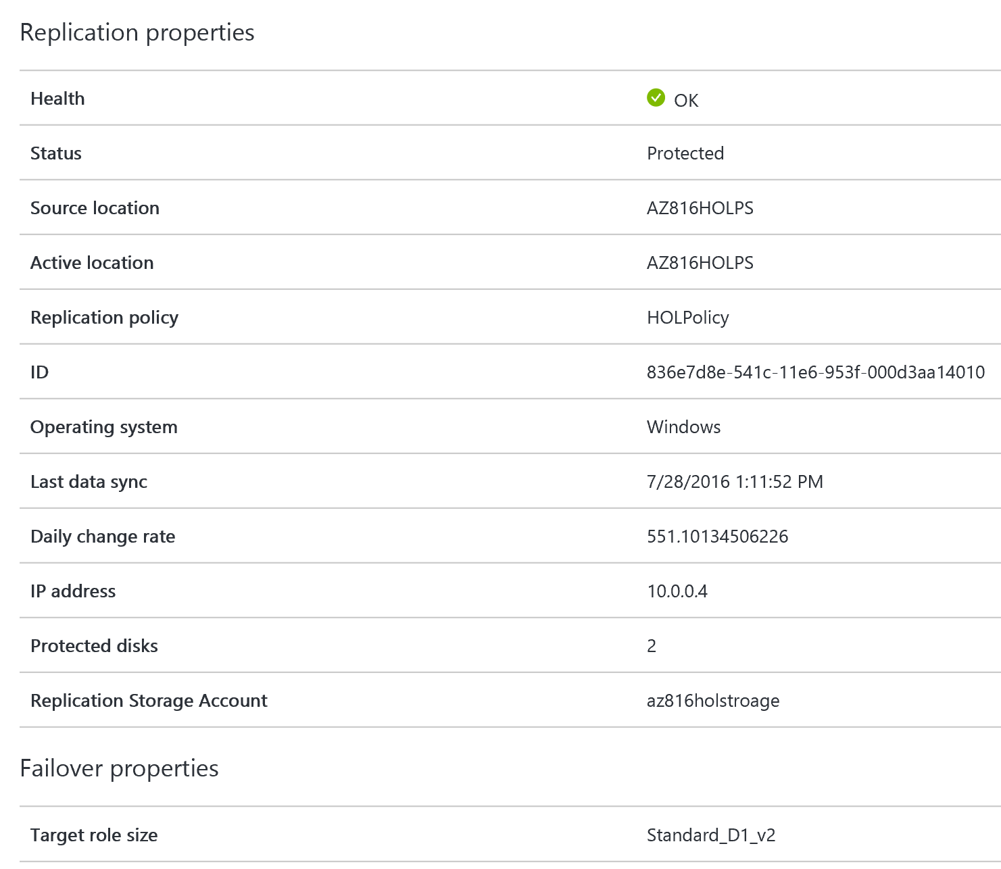
Enable Replication (3)
Click Settings > Replicated items > and select the machine. The Essentials blade shows information about machines settings and status.
In Properties you can view replication and failover information for the VM.

Slide 52
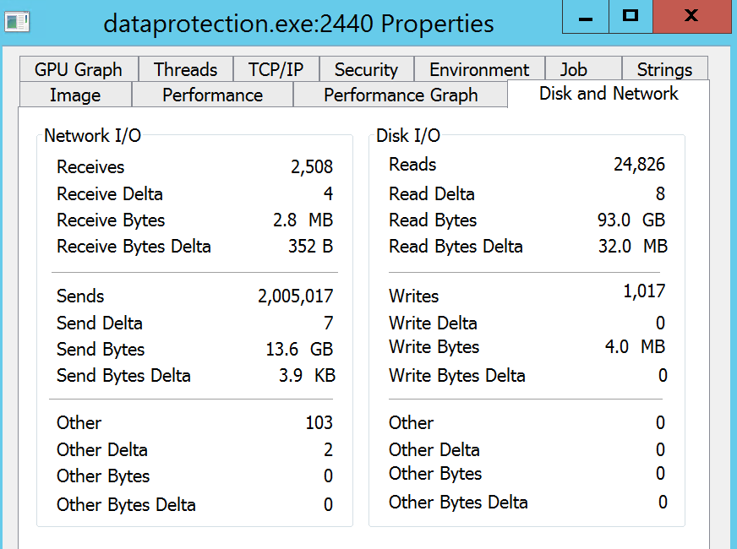
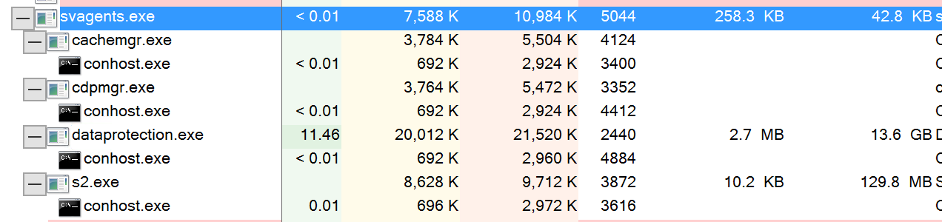
Monitoring IR on Target Machine
Remote to xxxHOLApp and open Internet Explorer then download Process Explorer from following url: https://technet.microsoft.com/en-us/sysinternals/processexplorer.aspx
Run Process Explorer and looking for process name svagents.exe, right-click sub-process name dataprotection.exe then select Properties
See the Sends/Receives value

Slide 53
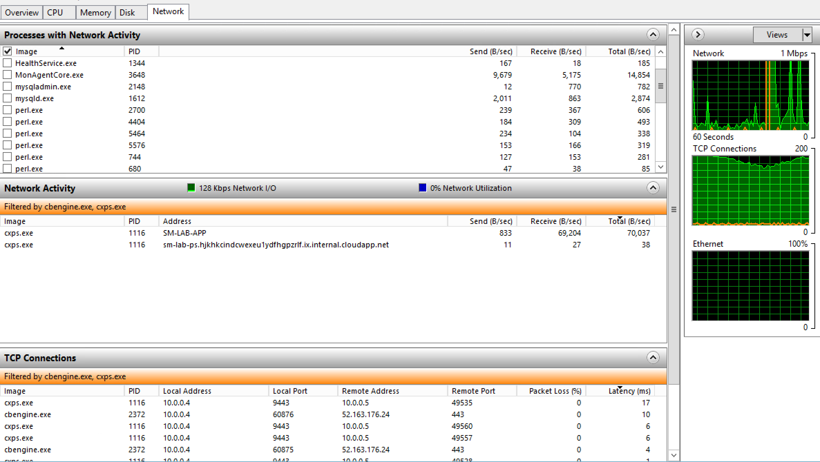
Monitoring Upload status on Process Server
Remote to xxxHOLPs and click Start then type Resource Monitor then press Enter
Select tab Network then select 2 processes: cbengine.exe and cxps.exe
Monitor Network Activity
Send
Receive
Monitor TCP Connections
Latency

Slide 54
View and manage VM properties
Click Settings > Replicated items > and select the machine. The Essentials blade shows information about machines settings and status.
In Properties you can view replication and failover information for the VM.
In Compute and Network > Compute properties you can specify the Azure VM name and target size.
In Disks you can see the operating system and data disks on the VM that will be replicated.

Slide 55
08 - Test the deployment

Slide 56
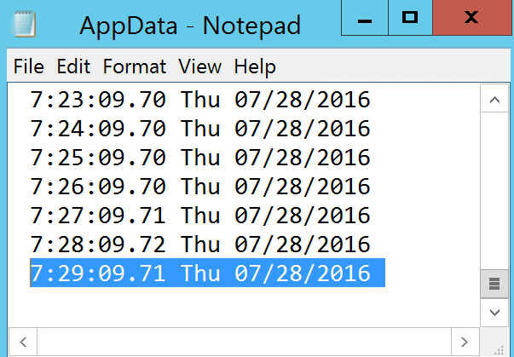

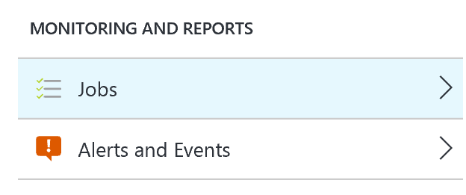

Perform Run a Test Failover
Remote connect xxxHOLApp
Open c:\AppData\appdata.txt and record the latest value at the bottom line
Switch to http://portal.azure.com To fail over a single machine, in Replicated Items > xxHOLApp > Settings, Click Test Failover icon.
Click OK to begin the failover. You can track progress by clicking on the VM to open its properties, or on the Test Failover job in vault name > Settings > Jobs > Site Recovery jobs.

Slide 57



Remote Connect to Test-Failover Machine
Wait until Test-Failover Job on the Complete testing stage
Switch Resource groups, click temporary Resource Group xxxHOLapp-test
Click, + Add
Type Public IP address, press Enter and click Ok
Create Name : Test-Failover-RDP, DNS name : xxHOLApp-Test and leave default value then click Create
Back to temporary machine, Click + Add
Type Network security group, press Enter and click Create
Enter name : xxxholapp-test, then click Create

Slide 58

Remote Connect to Test-Failover Machine (2)
Switch Test-Failover machine, Click Network interface > All settings > IP addresses
Click Public IP address > Enabled, IP addresss > xxHOLApp-Test Click Save
Click Network security group > Edit > xxxHOLApp-Test click Save
Click Network security group > All settings > Inbound security rules > click Add
Name : RDP
Port : 3389, click Ok.
Switch Test-Failover machine, click Connect
Open AppData.txt and compare RPO/RTO between On-Premise vs. Azure VM
Switch to Jobs > Test failover > Complete Test

Slide 59
Create Recovery Plan (For Multi-tier Applications)
Browse Site Recovery > RecoveryHOL > Settings > Site Recovery > + Recovery Plan
Name : My Recovery Plan
Source : xxxHOLPs
Target : Azure
Allow items with deployment model : Resource Manager
Select items : xxxHOLApp, click Ok
At new created Recovery Plan click … (right side) then click Customize
Explore Recovery Plan and menu

Slide 60
09 - Configuring Automation for OMS

Slide 61


Create Azure Automation Assets
Navigate to Azure Management Portal http://portal.azure.com
Click + New button
Type Automation then press Enter
Select Automation then click Create
Under Name type : MyAutomation
Resource Group : MyAutomationGroup
Location : Southeast Asia
Create Azure Run As account : Yes, click Create
On All resource click MyAutomation
Under Resources, click Assets

Slide 62
Create Azure Automation Assets (2)
Sadf On the Credential blade, click Credentials.
Click +Add a credential.
In the name field, type Automation Account.
In the User name and password fields, type the credentials admin@xxx.onmicrosoft.com used to log in to OMS and click Create.

Slide 63

Create a Runbook from Scratch
Switch to the MyAutomation tile, click Runbooks
Click Add a runbook, click Quick Create
In Name, type Write-HelloWorld.
From the Runbook type drop-down menu, select PowerShell Workflow and click Create
In the script area, edit the text to match the following:
Click Save

Slide 64
Test and Publish a Runbook
In the Edit blade for Write-HelloWorld, click Test pane.
Click Start.
When the runbook job completes, its output is displayed. (“Hello, world” will display)
Close the Test blade to return to the canvas.
Click Publish and click Yes.
Switch back into the Write-HelloWorld blade, click Start.
In the Start Runbook blade, click OK.
When the job completes, click Output.
The Output blade is opened, and you can see Hello World.

Slide 65

Start a Runbook on schedule
In the Write-HelloWorld blade, click Schedule.
In the Schedule Runbook blade, click Link a schedule to your runbook.
Click Create a new schedule.
In Name, type Daily.
Change the time to 5 minutes from the current time.
From the Recurrence drop-menu, select Daily.
Click Create.
In the Schedule Runbook blade, click OK.
Leave the Microsoft Azure portal window open for future tasks.

Slide 66

Import a Workflow to an OMS Runbook
Click the Automation tile and note the number of Runbooks.
Click Browse gallery
In the Search box, type create.
In the results, click Create a new Virtual (VM) on Azure
In the Create a new Virtual Machine (VM) on Azure blade, click Import.
In the Import blade, click OK.
Close open blades to return to the Runbooks blades.
Click New-AzureVMSample, In the New-AzureVMSample blade, click Edit.
In the Runbook blade, click Publish and click Yes.

Slide 67
10 – Enabling RemoteApp

Slide 68

Create Azure RemoteApp
Navigate to Azure Management Portal http://portal.azure.com
Click + New button
Type RemoteApp then press Enter
Select RemoteApp then click Create Note: It will switch to Classic Portal
Typing following input then click Create
Name: RemoteApp
Region: Southeast Asia
Plan: Basic
Template Image: Office Professional Plus 2013
Click CREATE REMOTEAPP COLLECTION (take up to 1 hour to complete provisioning)

Slide 69

Experience RemoteApp
Navigate to Azure Management Portal http://manage.windowsazure.com
Click Remote Desktop Client URL
Once RemoteApp website completely loaded click Try Now
Click Download the client
Open Azure RemoteApp and sig-in with your credential

